Slide 1
Mg C respired

Slide 2
Mg C respired

Slide 3
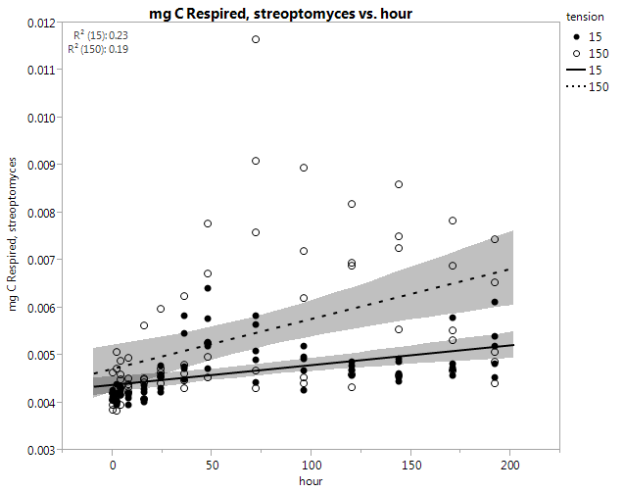
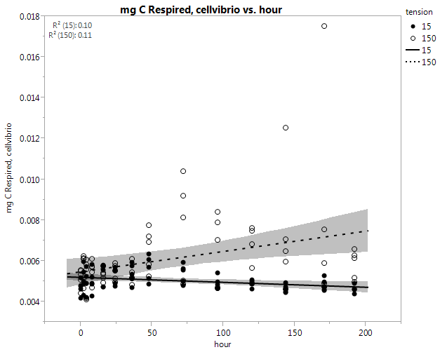
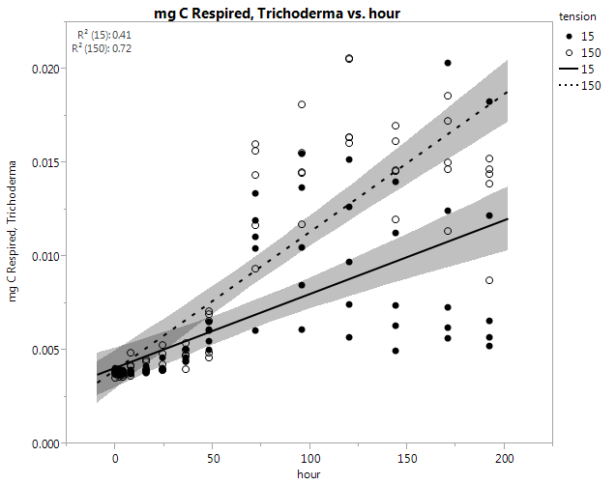
Mg C respired

Slide 4
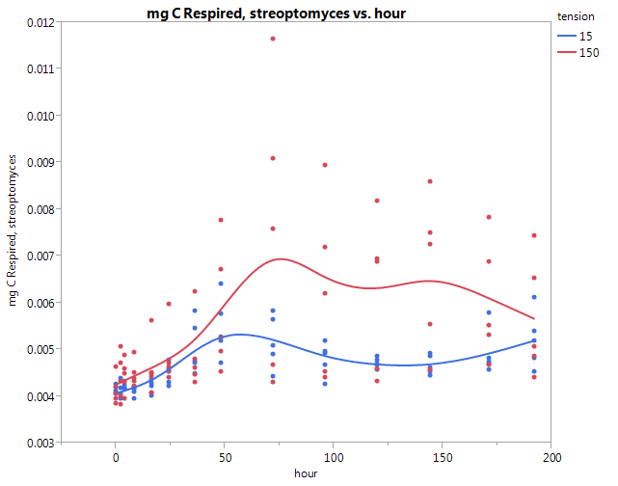
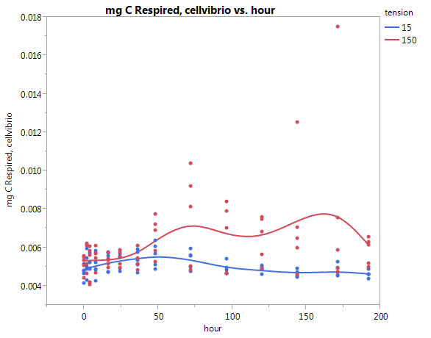
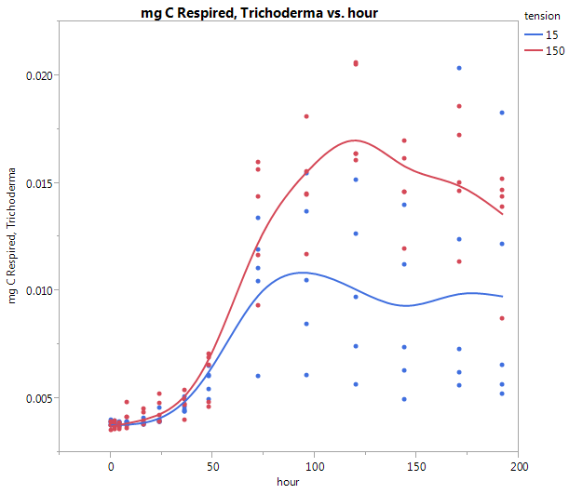
Mg C respired

Slide 5
CO₂ concentration

Slide 6
CO₂ concentration

Slide 7
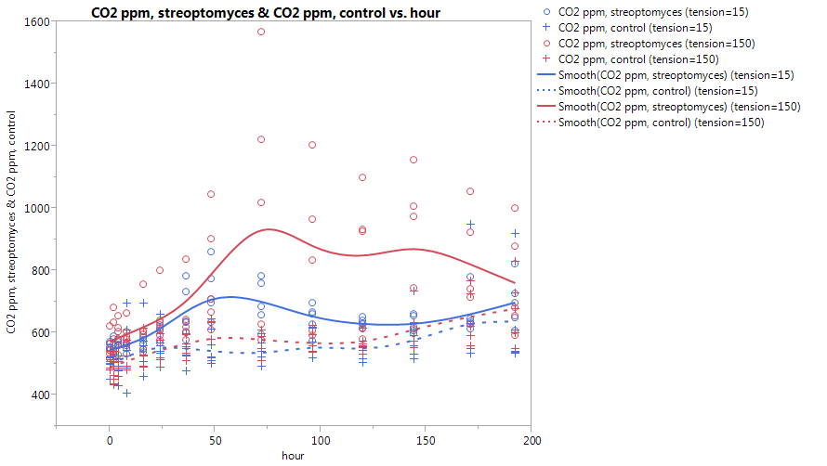
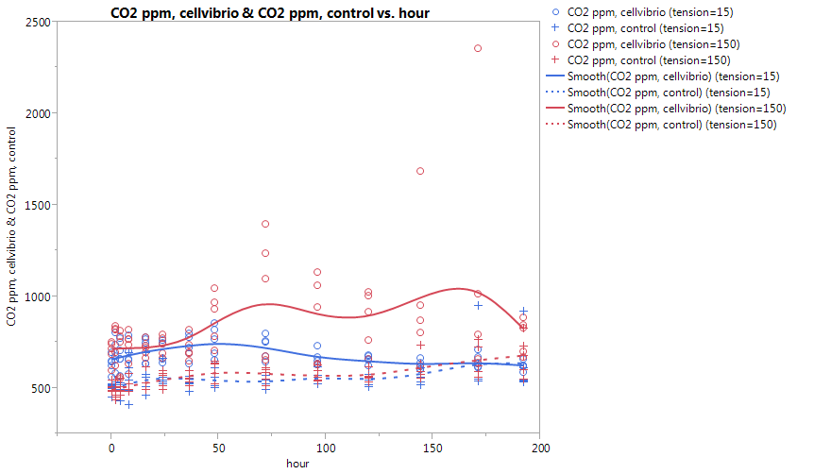
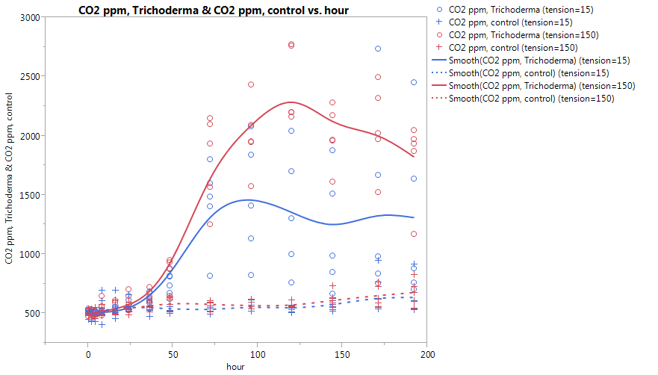
CO₂ concentration
(including controls)

Slide 8
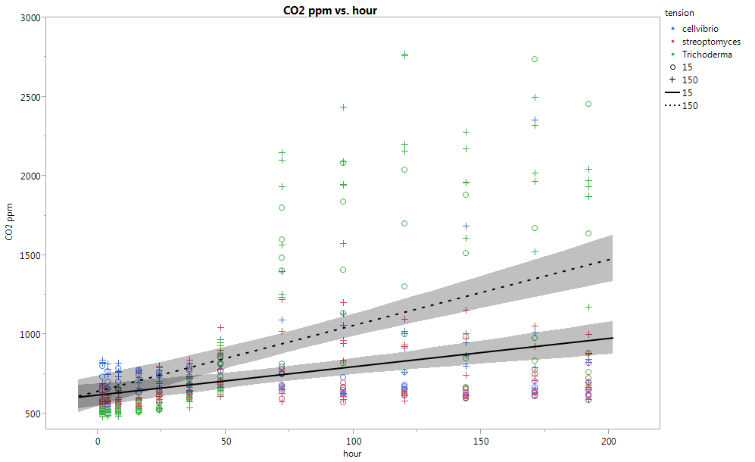
CO₂ concentration (all inoculants)

Slide 9
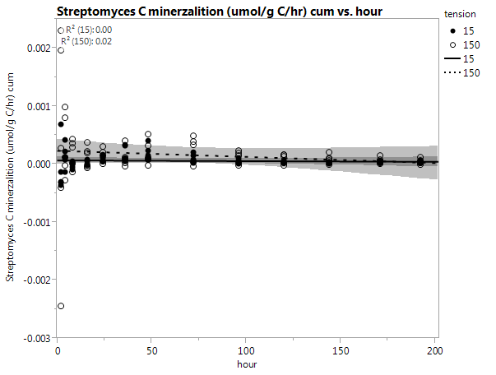
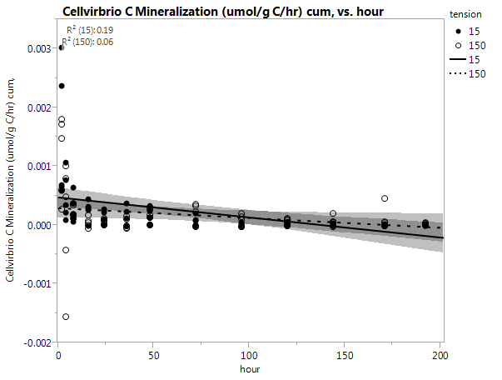
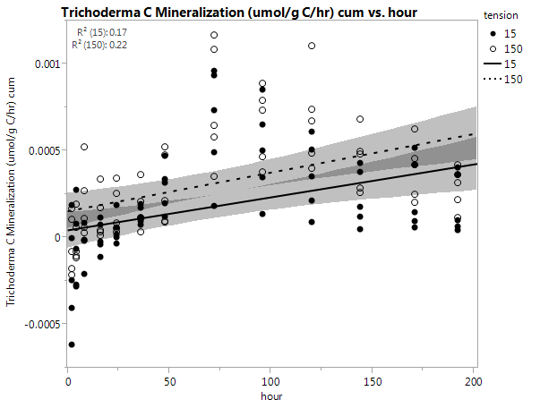
cumulative
C mineralization
(μmol/g C/hr)

Slide 10
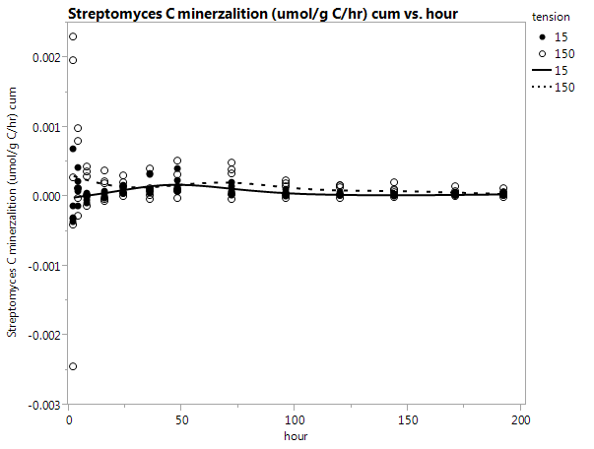
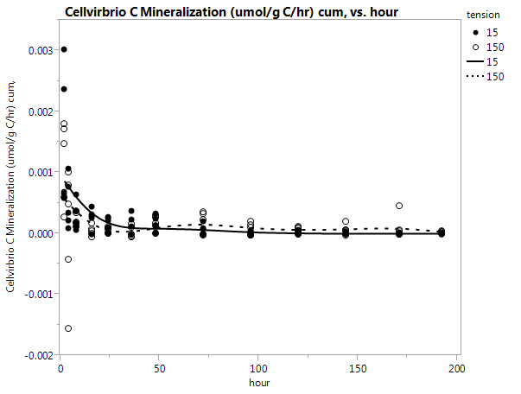
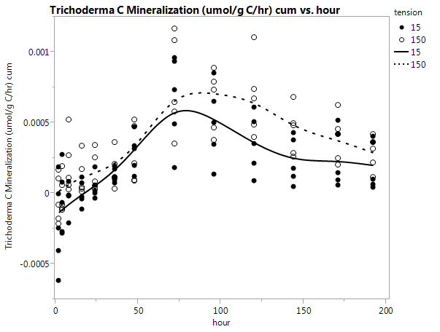
cumulative
C mineralization
(μmol/g C/hr)

Slide 11
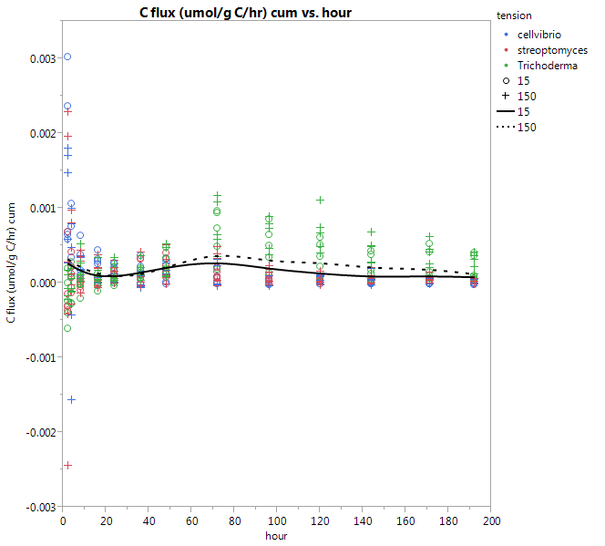
cumulative
C mineralization
For all inoculants (μmol/g C/hr)

Slide 12
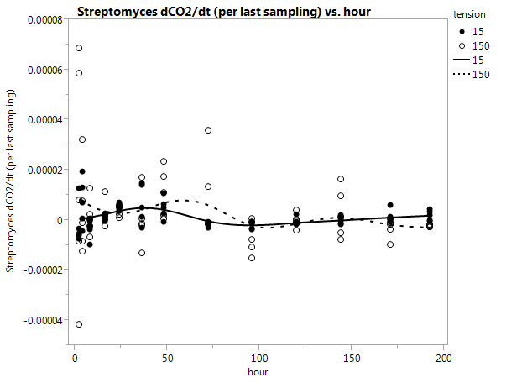
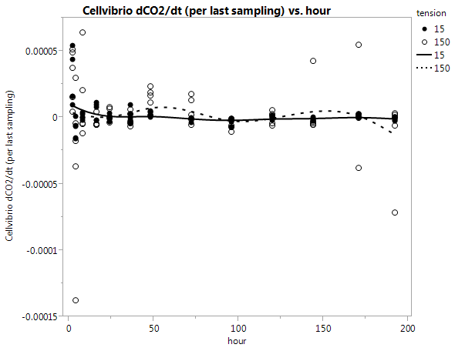
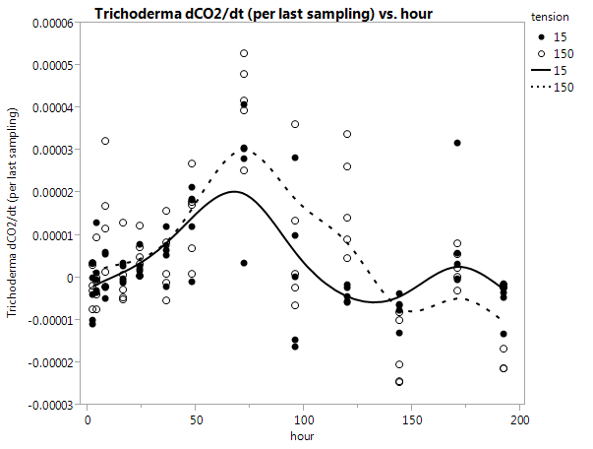
Respiration Rate
(ΔCO₂ hr⁻¹)
(from previous time point)

Slide 13
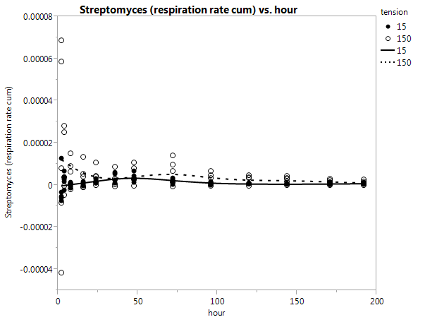
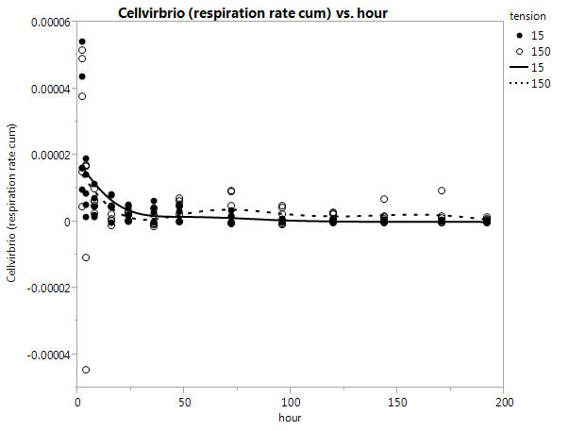
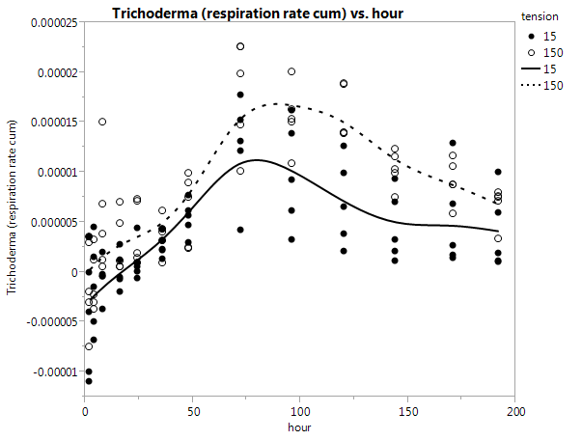
cumulative
Respiration Rate
(ΔCO₂ hr⁻¹)

Slide 14
Model Results
(CO2)
Main Effects | df | SS | F | p
Soil Core | 4 | 387705 | 1.72 | 0.1449
Incubation Time | 1 | 13864489 | 245.50 | <.0001
Pore Water Fraction | 1 | 2705357 | 47.90 | <.0001
Inoculant | 3 | 18411323 | 108.67 | <.0001
Inoculant × Pore Water Fraction | 3 | 1447450 | 8.54 | <.0001
Inoculant × Incubation Time | 3 | 20679997 | 122.06 | <.0001
Pore Water Fraction × Incubation Time | 1 | 1974760 | 34.97 | <.0001
Inoculant × Pore Water Fraction × Incubation Time | 3 | 1974760 | 34.97 | <.0001
df = degrees of freedom; SS = sum of squares
Table 1. Analysis of Variance for main effects and interactions of CO2 concentrations across incubation of pore water fractions pulled at different tensions (-15 and -150 mb pressure) from soil cores (n = 5), inoculated with pure cultures of select soil microorganisms.
Notes:
I have no idea why df = 1 for time when there are 13 different sampling times recorded.

Slide 15
Model Results
(C respired)
Table 1. Standard least squares for main effects and interactions of C respired across incubation of pore water fractions pulled at different tensions (-15 and -150 mb pressure) from soil cores (n = 5), inoculated with pure cultures of select soil microorganisms.
Main Effects | df | SS | F | p
Soil Core | 4 | 0.00002 | 2.42 | 0.05
Incubation Time | 13 | 0.00098 | 34.16 | <.0001
Pore Water Fraction | 1 | 0.00014 | 67.59 | <.0001
Inoculant | 3 | 0.00101 | 153.32 | <.0001
Inoculant × Pore Water Fraction | 3 | 0.00008 | 12.05 | <.0001
Inoculant × Incubation Time | 39 | 0.00153 | 17.76 | <.0001
Pore Water Fraction × Incubation Time | 13 | 0.00015 | 53.36 | <.0001
Inoculant × Pore Water Fraction × Incubation Time | 39 | 0.00014 | 1.65 | 0.01
df = degrees of freedom; SS = sum of squares
Notes:
I included time as non-numerical to get these results. It changed the significance of “core” as a main effect. I only did this because the df was so off for time when it was included as numerical….I have to look further.

